Slide 1
CSTE 3207
Session: 2020-21

Slide 2
Optical Fiber Communication

Slide 3
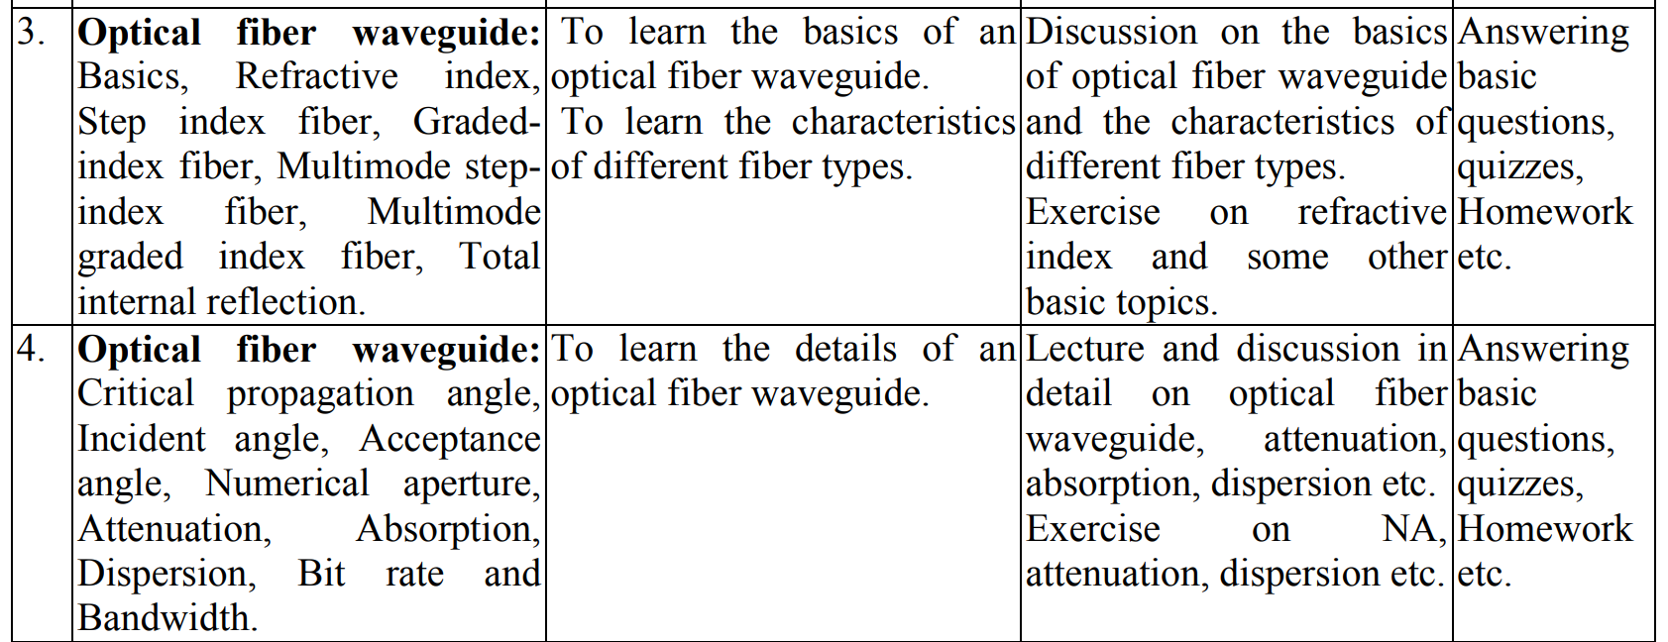

Slide 4
Outline
Mode
Fiber Impairments

Slide 5
Concept of Polarization

Slide 6
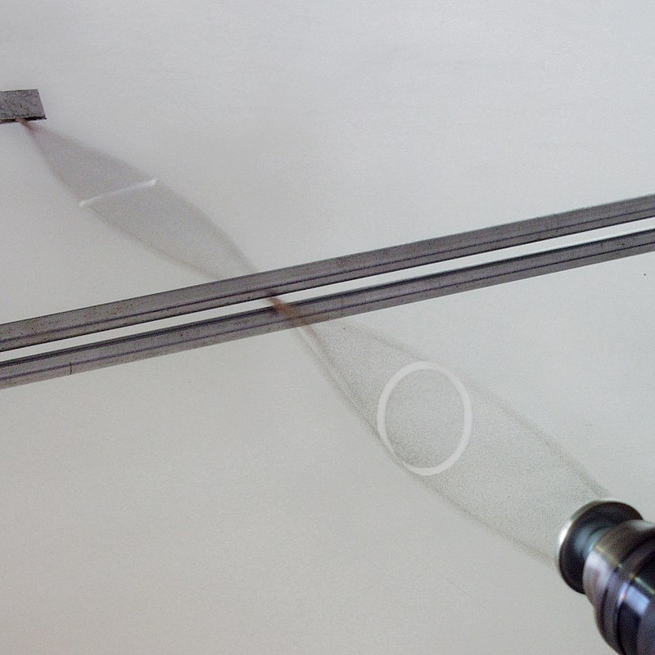
Polarization (Concept only)
Polarization is a property applying to transverse waves that specifies the geometrical orientation of the oscillations. In a transverse wave, the direction of the oscillation is perpendicular to the direction of motion of the wave. A simple example of a polarized transverse wave is vibrations traveling along a taut string- for example, in a musical instrument like a guitar string. Depending on how the string is plucked, the vibrations can be in a vertical direction, horizontal direction, or at any angle perpendicular to the string.

Slide 7
Mode

Slide 8
Mode
A set of guided electromagnetic waves is called the modes of an optical fiber. Maxwell's equations describe electromagnetic waves or modes having two components. The two components are the electric field, E(x, y, z), and the magnetic field, H(x, y, z).
The electric field, E, and the magnetic field, H, are at right angles to each other. Modes traveling in an optical fiber are said to be transverse. The transverse modes propagate along the axis of the fiber. Figure shows the mode field patterns are said to be transverse electric (TE).
In TE modes, the electric field is perpendicular to the direction of propagation. The magnetic field is in the direction of propagation. Another type of transverse mode is the transverse magnetic (TM) mode. TM modes are opposite to TE modes. In TM modes, the magnetic field is perpendicular to the direction of propagation. The electric field is in the direction of propagation.

Slide 9
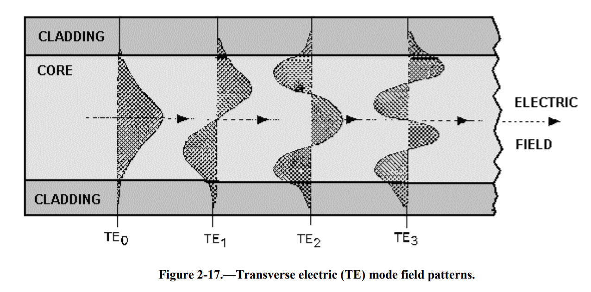
TE mode Pattern

Slide 10
Mode
The TE mode field patterns indicate the order of each mode. The order of each mode is indicated by the number of field maxima within the core of the fiber.
For example, TE₀ has one field maxima. The electric field is maximum at the center of the waveguide and decays toward the core cladding boundary. TE₀ is considered the fundamental mode or the lowest order standing wave.
As the number of field maxima increases, the order of the mode is higher. Generally, modes with more than a few (5-10) field maxima are referred to as high-order modes.
The order of the mode is also determined by the angle the wavefront makes with the axis of the fiber. Figure illustrates light rays as they travel down the fiber. These light rays indicate the direction of the wavefronts. High-order modes cross the axis of the fiber at steeper angles. Low-order and high-order modes are shown in figure.

Slide 11
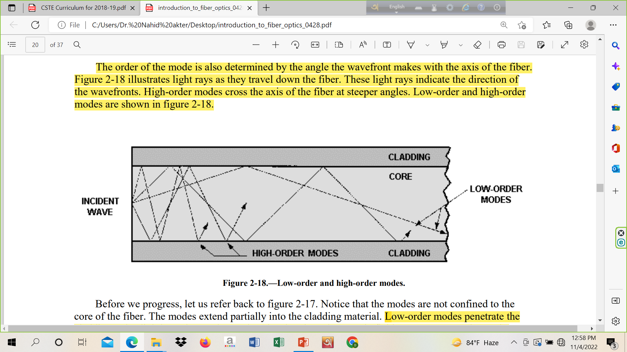
Low and High Order Modes Cross the Axis of the Fiber Core

Slide 12
Mode
We can notice that the modes are not confined to the core of the fiber. The modes extend partially into the cladding material. Low-order modes penetrate the cladding only slightly. In low-order modes, the electric and magnetic fields are concentrated near the center of the fiber. However, high-order modes penetrate further into the cladding material. In high-order modes, the electrical and magnetic fields are distributed more toward the outer edges of the fiber. This penetration of low-order and high-order modes into the cladding region indicates that some portion is refracted out of the core. The refracted modes may become trapped in the cladding due to the dimension of the cladding region. The modes trapped in the cladding region are called cladding modes. As the core and the cladding modes travel along the fiber, mode coupling occurs. Mode coupling is the exchange of power between two modes. Mode coupling to the cladding results in the loss of power from the core modes.

Slide 13
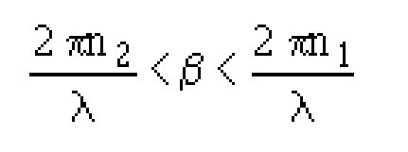
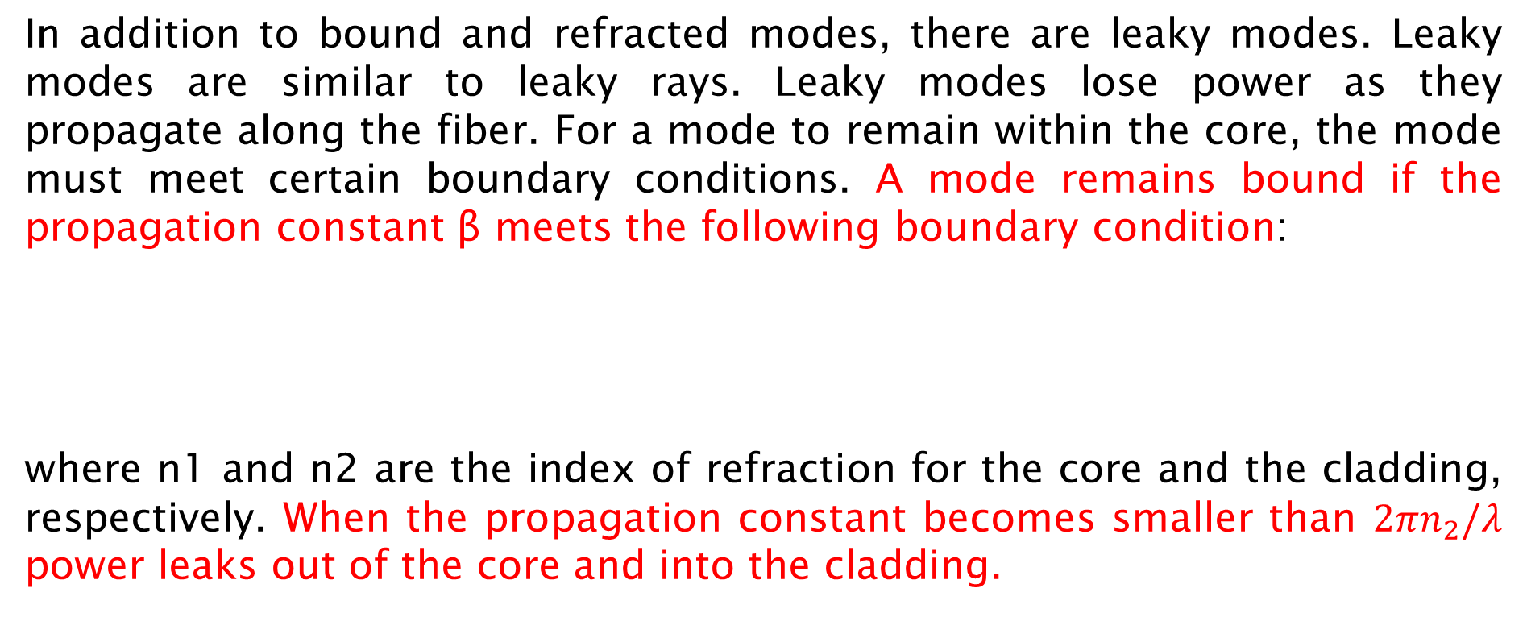
Mode
In addition to bound and refracted modes, there are leaky modes. Leaky modes are similar to leaky rays. Leaky modes lose power as they propagate along the fiber. For a mode to remain within the core, the mode must meet certain boundary conditions. A mode remains bound if the propagation constant β meets the following boundary condition:
where n1 and n2 are the index of refraction for the core and the cladding, respectively. When the propagation constant becomes smaller than $2πn_{2}/λ$ power leaks out of the core and into the cladding.

Slide 14
Linearly Polarized Modes

Slide 15
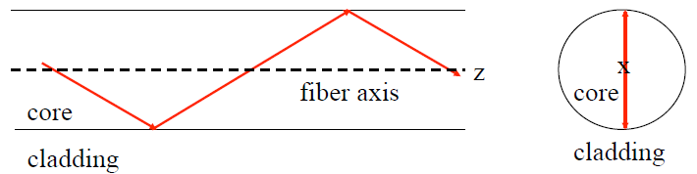
Vectorial Characteristics of Modes in Optical Fiber
TE (E_{z}=0) and TM (H_{z}=0) modes are corresponds to meridional rays (pass
through fiber axis).
As the circular optical fiber is bounded in two dimensions in the transverse
plane, two integers: l and m are necessary in order to specify the modes.
That’s why these modes refers to TE_{lm} and TM_{lm} modes.

Slide 16
Vectorial Characteristics of Modes in Optical Fiber
Hybrid modes are the modes in which both E_{z} and H_{z} are non-zero. These modes result from skew ray propagation (helical path without passing through the fiber axis). These modes are denoted as HE_{lm} and EH_{lm} depending on whether the components of H or E make larger contribution to the transverse field.
The full set of circular optical fiber modes therefore comprises: TE, TM (meridional), HE and EH (skew) modes.

Slide 17
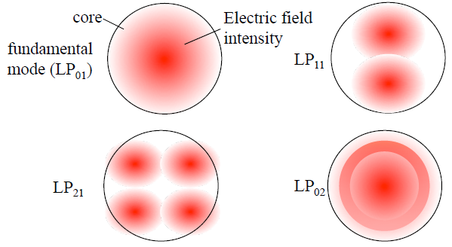
Linearly Polarized Modes
For Linearly polarized (LP) modes, designated as LP_{lm} are good approximations formed by exact modes TE, TM, HE, EH.
l and m describe the electric field intensity profile. There are 2l field
maxima around the fiber core circumference and m field maxima along the
fiber core radial direction.

Slide 18
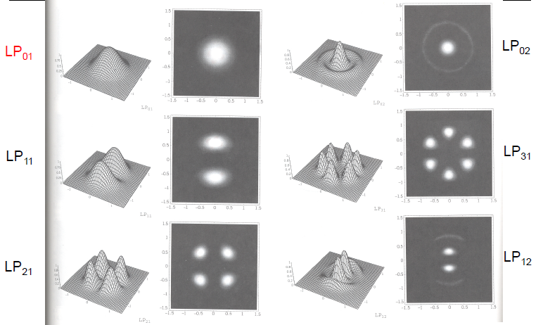
Intensity Plots for LP Modes

Slide 19
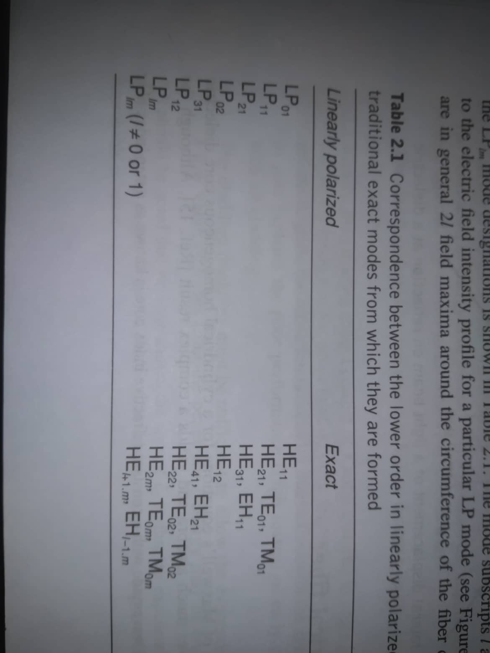
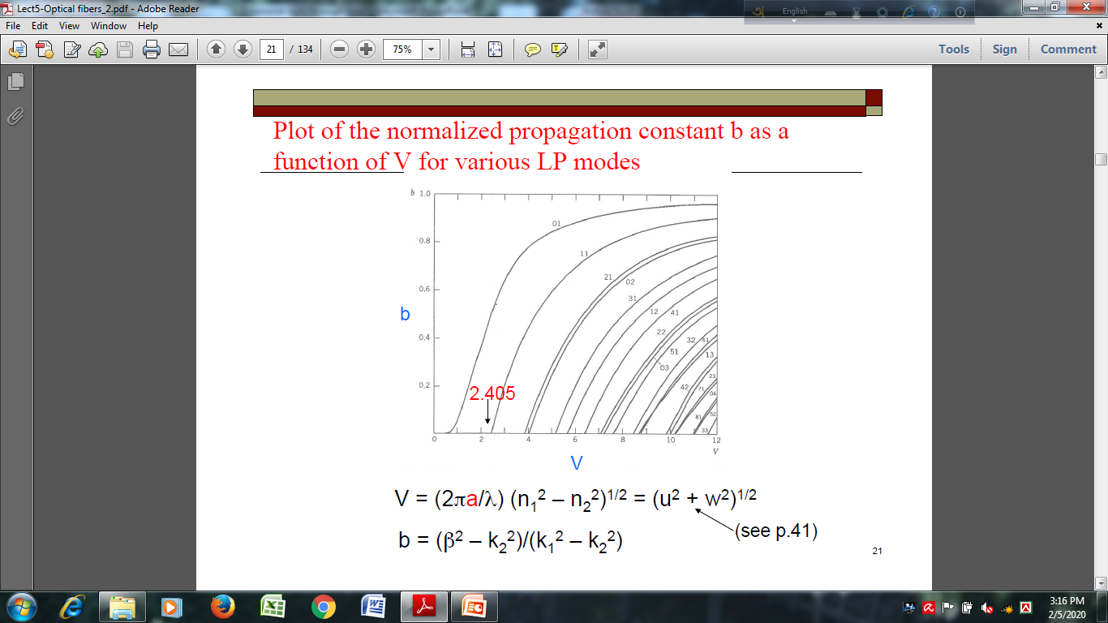

Slide 20
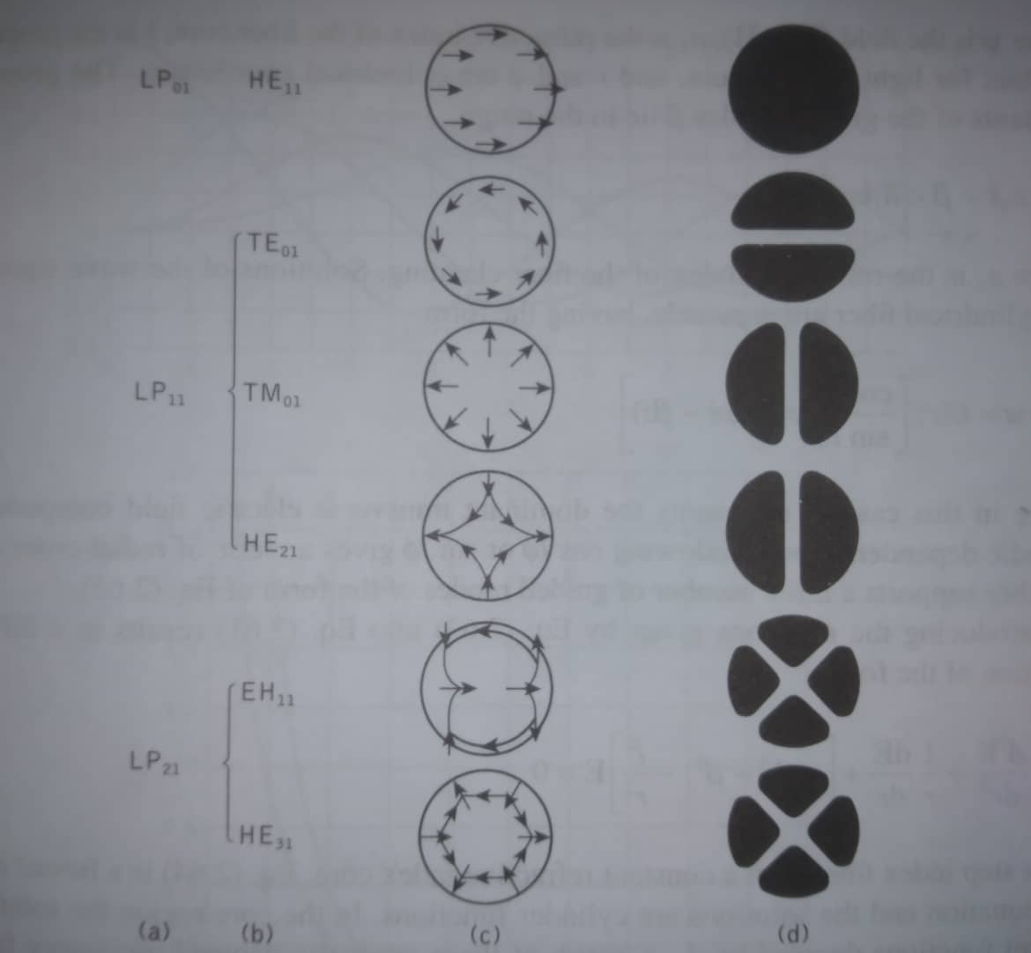

Slide 21
Fiber Impairments
See Ref Pdf
Attenuation (absorption {intrinsic, extrinsic, imperfection}, scattering {Rayleigh and mie} and bending loss {microbend and macrobend})
Dispersion (intramodal {material and waveguide dispersion} and intermodal or modal)

